Slide 1
UX - QHO428

Slide 2
UX
QHO428
User Persona
Week 3

Slide 3
Module Learning outcomes
On successful completion of this module, you will be able to
Identify the key component of User Experience context, including understanding the technology and stakeholders.
Interpret digital product or service requirements including business, technical and potential user sources and define appropriate measures of success, including goals, objectives and key performance indicators (KPIs).
Explain issues with usability and effectiveness of digital products and services and to identify areas for improvement.
Describe digital product usability, accessibility and other legal requirements.
Interpret user types and their goals, behaviours and pain points using appropriate design artefacts to inform the design process.

Slide 4
Assessment
Assignment : 100% - Individual written report

Slide 5
Week 3- Objectives
Usability
User Persona

Slide 6
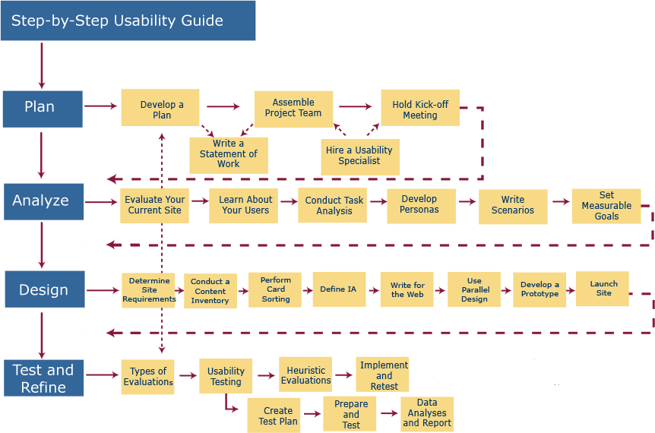
from http://www.usability.gov/methods/process.html

Slide 7
from http://www.usability.gov/methods/process.html

Slide 8
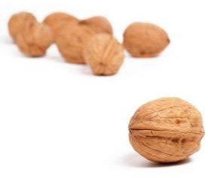
User Personas are representations created to emphasize and personalize limitations, goals and behaviour patterns of a target audience.

Slide 9
User Personas are representations created to emphasize and personalize limitations, goals and behavior patterns of a target audience.
It is a key concept
in user centered design practices.

Slide 10
What are User Personas?
A persona is a hypothetical archetype it represents:
  A specific person in a work role
  With user characteristics
We put the fictional version of a user through user scenarios
  Before real users
The first question we must always ask ourselves is
  "who is using this?“
This allows to keep the product focused
  A product that is all things to all users will be a dancing bear!
Notes:
Possibly the most useful tool for the early stages of usability design is the User Persona.
What is a User Persona?
An amalgamation of data derived from users and potential users in order to create composites of the sort of people using your software and what (and how) they will be doing with it.
These are built from interviews and questionnaires as well as user stories.
How does it help?
Because it contains details of how a user behaves, what their goals and skills are, and what sort of environment they will be working in, this can help take a usability design process most of the way to completion by putting a fictional version of a user through user scenarios before real users.

Slide 11
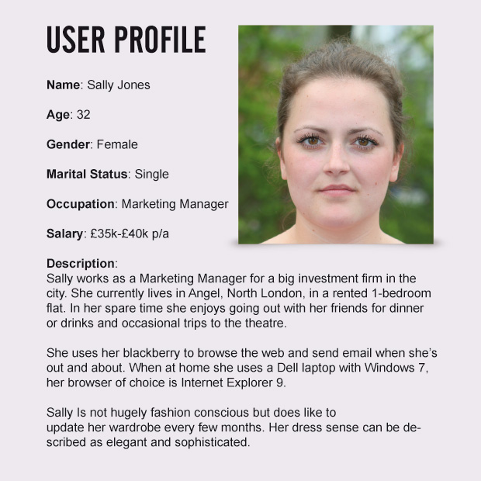
User Persona – simple example
Example taken from http://www.basecreative.eu

Slide 12
How Do You Use Personas?
Personas are a tool to control the instinct to cover everything
  We can try to remove the edge cases
  This allows us to focus on the critical users
Consider the following scenario:
  What if the user wants to do x?
  Can we afford not to include x?
  How about putting it in the next version?
Consider the same scenario with a profile:
  Sally will not need feature x
  But someone might need feature x
  We are not developing for Sally, not ‘someone’
Notes:
Personas offer a focus at the start of the analysis. They allow us to work out profiles for possible users and define a set of behaviours for them. It allows us to wheedle out ‘edge cases;, which are extremely exceptional or unlikely users that may creep into open plan discussion at the start of strategy modelling. For example, an app for social networking on cinema experiences would want to exclude users who never go to the cinema together for whatever reason, their ‘experience’ may not be what we wish to reach with our product.
Designers design for themselves, they are to close to the product in many cases, developers have exactly the same problem! Personas help us overcome the struggle of trying to design for to many conflicting needs and tries to focus the initial design work around the basis of likely users. A specific person makes clear what functionality or features must be included and what can be omitted. It is easier to quantify what a user wants if the user is known.

Slide 13

History of User Persona:
Alan Cooper’s The Inmates are Running the Asylum (1998) popularized the concept of user personas for software development.

Slide 14
Benefits of User Personas:
Users' goals and needs become a common point of focus for the team.
The team can concentrate on designing for a manageable set of personas knowing that they represent the needs of many users.
By always asking, "Would Jim use this?" the team can avoid the trap of building what users ask for rather than what they will actually use.
Disagreements over design decisions can be sorted out by referring back to the personas.
Designs can be constantly evaluated against the personas, getting better designs into usability testing.

Slide 15
How to Create Persona
The details of a persona has to be a rich life story
  It must be specific and precise
  Personas must be relevant and believable
Information that you might want to include in your user persona includes:
  Who – age, location, gender, education, job title
  Environment – when and where are they using your site? What device are they using?
  Tasks – what tasks are they trying to complete on your site?
  Motivation – what is their broader desired outcome?
  Name or nickname
  A photo
Notes:
Once you have this information, you should be able create personas. Generally 2-4 is a good amount. You might also want to pick a primary persona if there is a specific user group that is particularly prominent in your research – this persona should be prioritized when applying personas to decision making.
Once you’ve created the multiple personas, it might be useful to create a document similar to those in the examples above so that they can easily be shared and referenced.

Slide 16
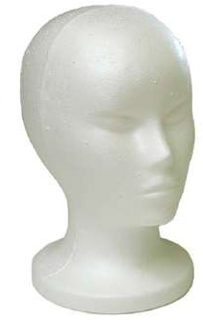
How to create User Personas
Planning,
Gathering Data,
Analyzing the Data
Create a User Persona
Design Deliverable

Slide 17

Planning
What type of information do you already have on your users?
What other information do you need?
How will you get it?

Slide 18
How do you get information
Contextual Interviews
Individual Interviews
Surveys (Online)
Focus Groups
Usability Testing

Slide 19
Gathering Data
Who is this?
Where will they use this?
Usage Environment
Why will they use this?
Motivation, Goals

Slide 20
Analyze the Data
Personality-
background, characteristics, interaction
habits, attitudes, goals
Activities- habits, user patterns, levels of experience
Shared vocabulary- stories of interactions, specific words

Slide 21
Create the User Persona
Personality-
background, characteristics, interaction
habits, attitudes, goals
Activities- habits, user patterns, levels of experience
Shared vocabulary- stories of interactions, specific words

Slide 22
Design the Deliverable
Why?
It is a document that can be referred to during the design process.
Creates a shared vocabulary for developers,
designers, manage rs and shareholders.
Helpful for long development cycles
It reminds you what your goals are!

Slide 23

Design the Deliverable
Name and Photo Demographics (age, education,
ethnicity, family status)
Job title and major responsibilities Goals and tasks in relation to your
site
Environment (physical, social, technological)
A quote that sums up what matters most to the persona with relevance for your site

Slide 24
Design the Deliverable
Name : Ellen Noel Demographics
(age, education, ethnicity, famil y status)
Job title and major responsibilities Goals and tasks in relation to your
site
Environment
(physical, social, technological)
A quote that sums up what matters most to the persona with relevance for your site
A quote that sums up what matters most to the persona with relevance for your site

Slide 25
Design the Deliverable
Name: Ellen Noel Demographics:
Age 8, elementary school, Dutch Job title and major responsibilities Goals and tasks in relation to your
site
Environment
(physical, social, technological)
A quote that sums up what matters most to the persona with relevance for your site
A quote that sums up what matters most to the persona with relevance for your site

Slide 26
Design the Deliverable
Name: Ellen Noel Demographics:
Age 8, elementary school, Dutch Job title and major responsibilities Goals and tasks in relation to your
site
Environment
(physical, social, technological)
A quote that sums up what matters most to the persona with relevance for your site
A quote that sums up what matters most to the persona with relevance for your site

Slide 27
Design the Deliverable
Name: Ellen Noel Demographics:
Age 8, elementary school, Dutch Job title and major responsibilities Get good grades in school
Goals and tasks in relation to your site
A quote that sums up what matters most to the persona with relevance for your site
Environment
(physical, social, technological)
A quote that sums up what matters most to the persona with relevance for your site

Slide 28
Design the Deliverable
Name: Ellen Noel Demographics:
Age 8, elementary school, Dutch Job title and major responsibilities Get good grades in school
Goals and tasks in relation to your site:
A quote that sums up what matters most to the persona with relevance for your site
Environment
(physical, social, technological)
A quote that sums up what matters most to the persona with relevance for your site

Slide 29
Design the Deliverable
Name: Ellen Noel Demographics:
Age 8, elementary school, Dutch Job title and major responsibilities Get good grades in school
Goals and tasks in relation to your site: Learn English Idioms
A quote that sums up what matters most to the persona with relevance for your site
Environment
(physical, social, technological)
A quote that sums up what matters most to the persona with relevance for your site

Slide 30
Design the Deliverable
Name: Ellen Noel Demographics:
Age 8, elementary school, Dutch Job title and major responsibilities Get good grades in school
Goals and tasks in relation to your site: Learn English Idioms
A quote that sums up what matters most to the persona with relevance for your site
Environment
(physical, social, technological)
A quote that sums up what matters most to the persona with relevance for your site

Slide 31
Design the Deliverable
Name: Ellen Noel Demographics:
Age 8, elementary school, Dutch Job title and major responsibilities Get good grades in school
Goals and tasks in relation to your site: Learn English Idioms
Environment
(physical, social, technological):
Uses shared computer in family room, enjoys sharing accomplishments with family, does not understand operating system but does surf the web
A quote that sums up what matters most to the persona with relevance for your site

Slide 32
Design the Deliverable
Name: Ellen Noel Demographics:
Age 8, elementary school, Dutch Job title and major responsibilities Get good grades in school
Goals and tasks in relation to your site: Learn English Idioms
Environment
A quote that sums up what matters most to the persona with relevance for your site
(physical, social, technological): Uses shared computer in family room, enjoys sharing accomplishments with family, does not understand operating system but does surf the web

Slide 33
Design the Deliverable
Name: Ellen Noel Demographics:
Age 8, elementary school, Dutch Job title and major responsibilities Get good grades in school
Goals and tasks in relation to your site: Learn English Idioms
Environment
(physical, social, technological): Uses shared computer in family room, enjoys sharing accomplishments with family, does not understand operating system but does surf the web
I can do anything I put my mind to.
And I can do everything better than my brother.

Slide 34
Review: User Personas
Planning,
Gathering Data,
Analyzing the Data
Create a User Persona
Design Deliverable

Slide 35
What you should know
User Personas

Slide 36
Week 3 - Seminars
Create a User Persona for the potential users of the following devices
  Fast Food Till.
  Customer Relationship Management Suite.
  Social Media Application.
  Government Information Website.
  Interactive news media Website.
  Free to play web game.

Slide 37
Recommended Books
Unger, R. and Chandler, C., 2012. A project guide to UX design. Berkeley, Calif: New Riders.
Garrett, J., 2011. The elements of user experience. Berkeley, CA: New Riders.

